Slide 1


Introduction to Artificial Intelligence
CHANDRADEEP BHATT
Department of CSE
Graphic Era Hill University
Dehradun

Slide 2
Definition of AI
AI = Artificial (Man Made)
+ Intelligence(Power of thinking)
Intelligence Factor
Reason
Learn
Perceive
Problem solving
Understand

Slide 3
Artificial intelligence (AI) is wide-ranging branch of computer science concerned with building smart machines capable of performing tasks that typically require human intelligence.

Slide 4
TOP Companies using AI
Alibaba
Alphabet
Google Duplex
Amazon
Amazon Go
Bai Du
Facebook
JD.Com
Microsoft

Slide 5
State Space Representation
Problem solving require expert system (Agents)
Techniques of Problem Solving Representation in AI
State Space representation
Problem reduction

Slide 6
State Space Representation
State ----- Info------ Action------ Goal
Initial Node
Intermediate nodes
Actions (Set of Operators)
Final Node

Slide 7
Example
Installing An Application from play store
Search Application
Choose desired Application
Accept ‘T&C’
Error
Accepted
App Not Installed
Installed
Successfully Installed

Slide 8
Intelligent System
Intelligent systems solve complex problems automatically and more efficiently within specific environments. They are formed by the collaboration of people and technologies such as Big Data, the IoT ("Internet of things"), mobile networks (3G, 4G, 5G) AI or artificial intelligence, robotics, video analytics, computer vision, and augmented reality, among others.

Slide 9
An intelligent system is an advanced computer system that can gather, analyze and respond to the data it collects from its surrounding environment. It can work and communicate with other agents, such as users or other computer systems. It can also learn from experience and adapt according to current data.

Slide 10
Examples
ndustry | Examples
Transportation | Traffic control systems, traffic flow analysis and congestion monitoring,
Aerospace | drones, spacecraft monitoring, mission planning, advanced guidance and navigation, air traffic control
Human identification | Visual surveillance, biometric monitoring (such as face or fingerprint recognition), character or speech recognition
Climatology | Forecasting, advance warning systems (such as tornados or tsunamis), field research and monitoring, satellite imaging and analysis
Retail | Online shopping recommendations, product planning and delivery
Home automation | Smart appliances, climate and lighting control, entertainment

Slide 11
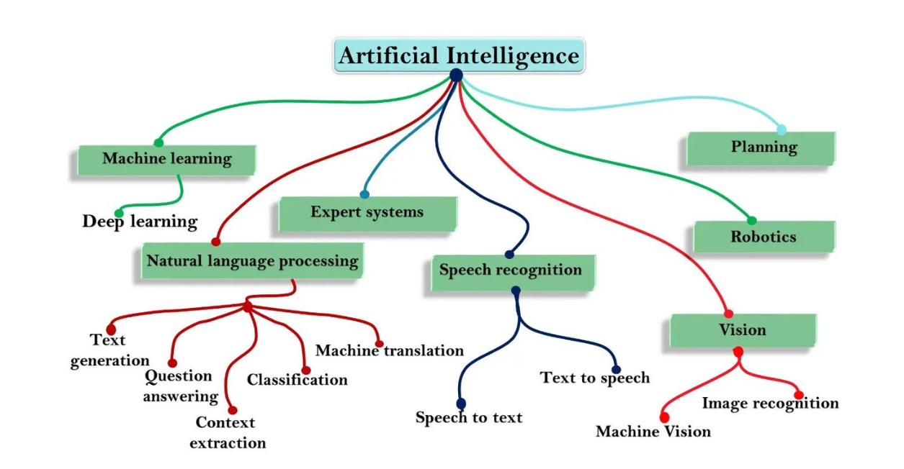
Categorization of AI

Slide 12
EXPERT SYSTEM
MYCIN: Developed at Stanford University in the 1970s, MYCIN was one of the earliest and most famous expert systems. It was designed to diagnose bacterial infections and recommend antibiotic treatments based on patient symptoms and laboratory test results.
DENDRAL: Developed in the 1960s at Stanford University, DENDRAL was an expert system in the field of organic chemistry. It was used to analyze mass spectrometry data and identify the chemical structure of organic compounds

Slide 13
Machine learning system
Image Recognition and Classification:
  Google Photos: Google Photos uses machine learning algorithms to automatically categorize and tag photos based on their content, allowing users to easily search for specific images.
  Facebook's DeepFace: Facebook's DeepFace system uses deep learning algorithms to recognize faces in photos uploaded to the platform, enabling automatic tagging and facial recognition features.
Natural Language Processing (NLP):
  Google Translate: Google Translate employs machine learning techniques, including neural machine translation, to translate text between languages with high accuracy.
  Amazon Alexa, Apple Siri, Google Assistant: Virtual assistants like Alexa, Siri, and Google Assistant utilize natural language understanding and processing algorithms to interpret and respond to user voice commands and queries.

Slide 14
Computer vision system
Facial Recognition Systems:
Apple Face ID: Apple's Face ID technology uses computer vision algorithms to recognize and authenticate users based on their facial features, enabling secure access to devices such as iPhones and iPads.
Facebook's DeepFace: Facebook's DeepFace system utilizes deep learning techniques for facial recognition in photos uploaded to the platform, enabling automatic tagging and content moderation.
Surveillance and Security:
Closed-Circuit Television (CCTV) Systems: Many surveillance systems use computer vision algorithms for real-time monitoring, object tracking, and anomaly detection in video footage to enhance security in public spaces, airports, banks, and other facilities.
Smart Home Security Cameras: Smart home security cameras equipped with computer vision capabilities can detect and recognize people, pets, and specific activities, sending alerts to homeowners' smartphones in case of suspicious events

Slide 15
Robotics system
Industrial Robots:
  Fanuc Robots: Fanuc is a leading manufacturer of industrial robots used in manufacturing and automation processes, including welding, painting, assembly, and material handling tasks.
  ABB Robotics: ABB Robotics provides a wide range of industrial robots and robotic automation solutions for industries such as automotive, electronics, and food and beverage.
Service Robots:
  Softbank Robotics' Pepper: Pepper is a humanoid service robot designed to interact with humans in various settings, including retail environments, airports, and healthcare facilities, providing assistance, information, and entertainment.
  Boston Dynamics' Spot: Spot is a quadruped robot developed by Boston Dynamics for a variety of applications, including inspection, surveillance, and remote monitoring in industries such as construction, oil and gas, and public safety.

Slide 16
Thank you

